Slide 1


Slide 2
Indrakeenam’s Member
Firman Maulana 05111640000059
Vinsensius Indra Suryanto 05111640000064
Rahma Sofyantoro 05111640000117

Slide 3
Contextual
Inquiry and Analysis
LOL CTF
A Capture The Flag Website By Indrakeenam

Slide 4
Contextual Inquiry
User
Descriptions
1
Male
2
Male
3
Male
4
Male
Informatics Student
Informatics Student
Informatics Student
Informatics Student
Batch 2017
Batch 2017
Batch 2017
Batch 2016
Never
Active
Active
Never
Do CTF Before
Competitive Programmer
CTF User
Do CTF Before
Never
Never
Active
Seen
Open CTF Website
Open CTF Website
CTF Website User
CTF Website
Zero
Know
Active
Know
Knowledge About CTF
CTF by Activity
Understand
CTF by Activity and View
Notes:
Competitive Programming is similar with CTF when doing their competition

Slide 5
Contextual Inquiry
User
Descriptions
1
Male
Informatics Student
Batch 2017
Never
Do CTF Before
Never
Open CTF Website
Zero
Knowledge About CTF
Notes:
Competitive Programming is similar with CTF when doing their competition

Slide 6
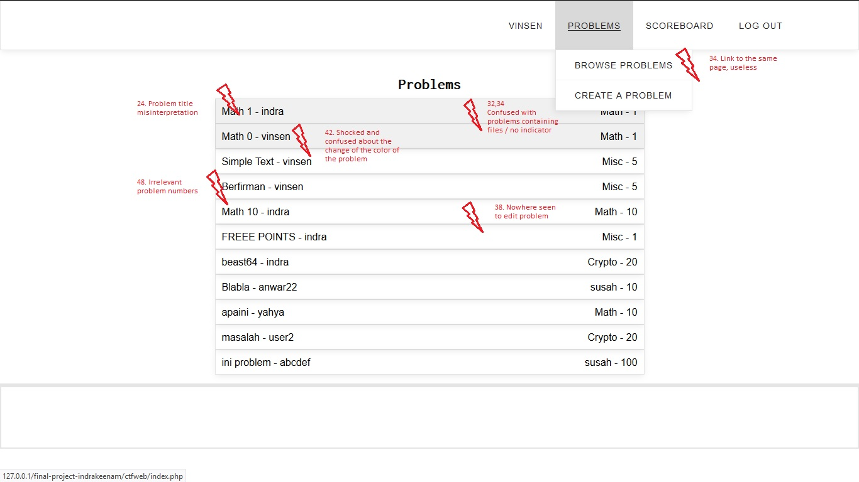
Contextual Analysis
1
Artifact Model
Notes:
Competitive Programming is similar with CTF when doing their competition

Slide 7
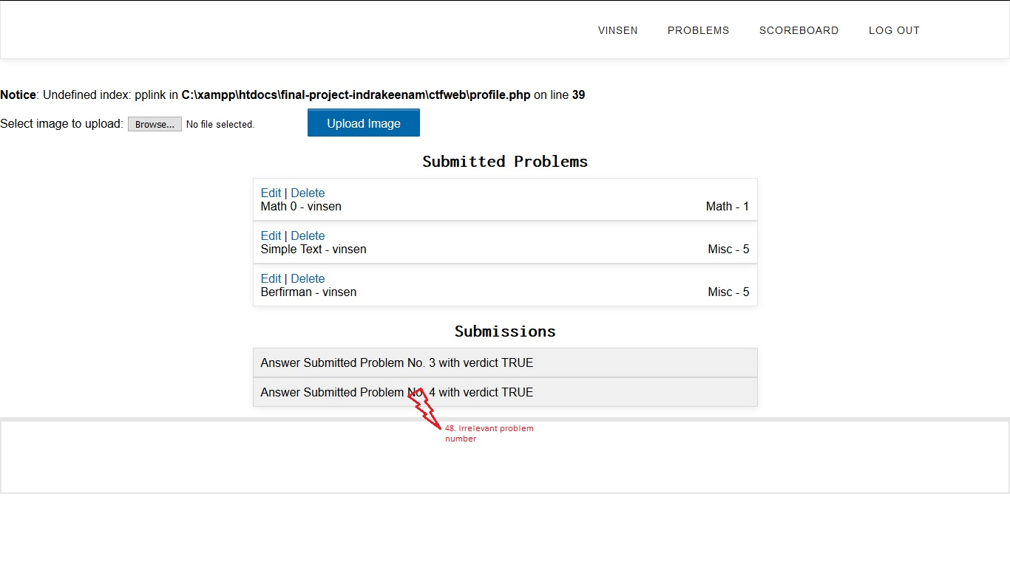
Contextual Analysis
1
Artifact Model
Notes:
Competitive Programming is similar with CTF when doing their competition

Slide 8
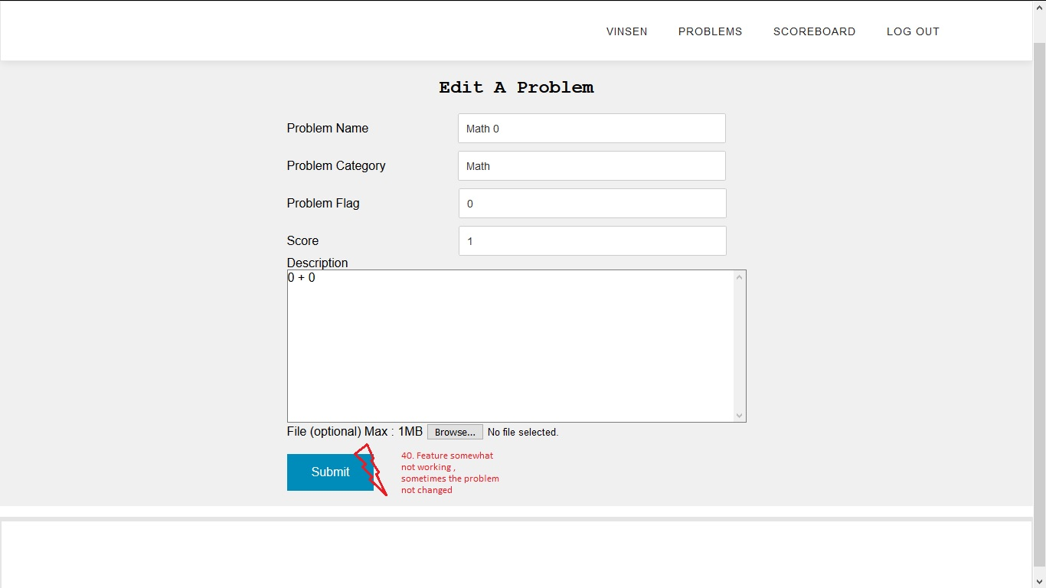
Contextual Analysis
1
Artifact Model
Notes:
Competitive Programming is similar with CTF when doing their competition

Slide 9
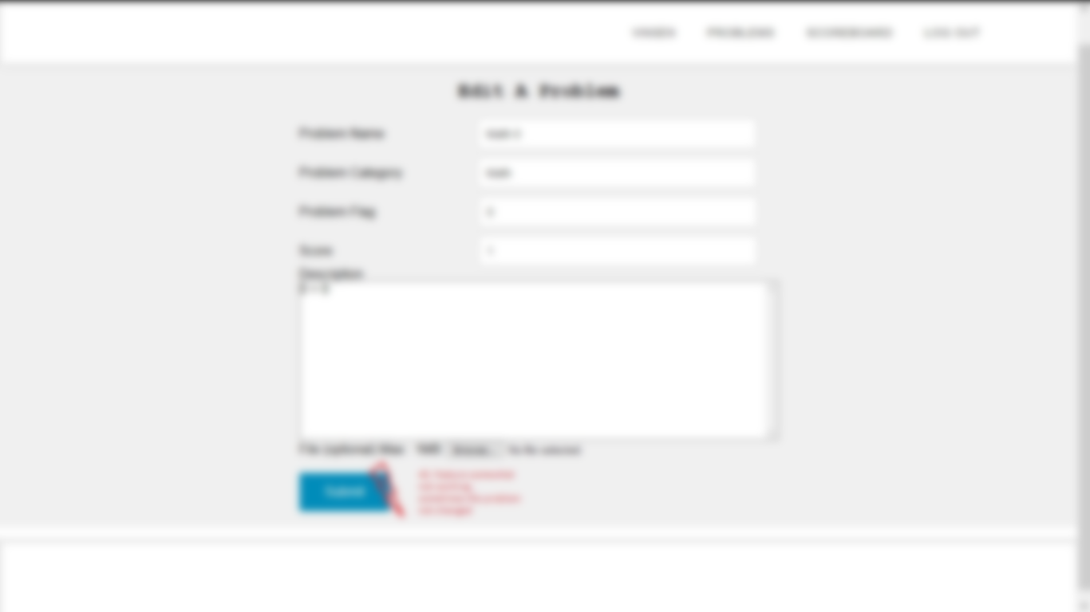
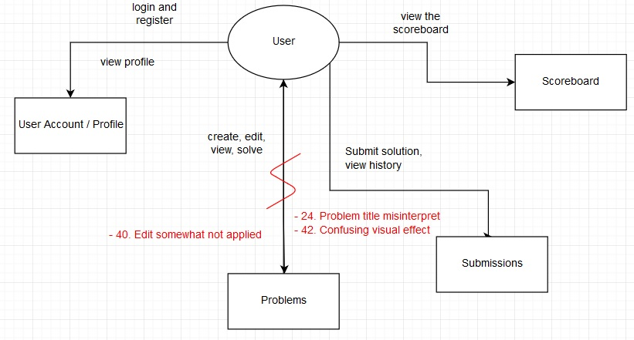
Contextual Analysis
1
Flow Model
Notes:
Competitive Programming is similar with CTF when doing their competition

Slide 10
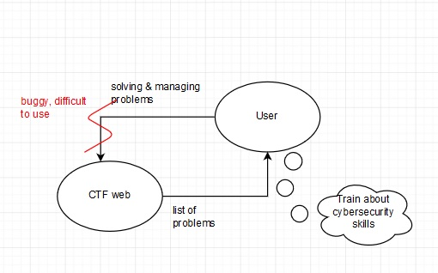
Contextual Analysis
1
Cultural Model
Notes:
Competitive Programming is similar with CTF when doing their competition

Slide 11
Contextual Inquiry
User
Descriptions
2
Male
Informatics Student
Batch 2017
Active
Competitive Programmer
Never
Open CTF Website
Know
CTF by Activity
Notes:
Competitive Programming is similar with CTF when doing their competition

Slide 12
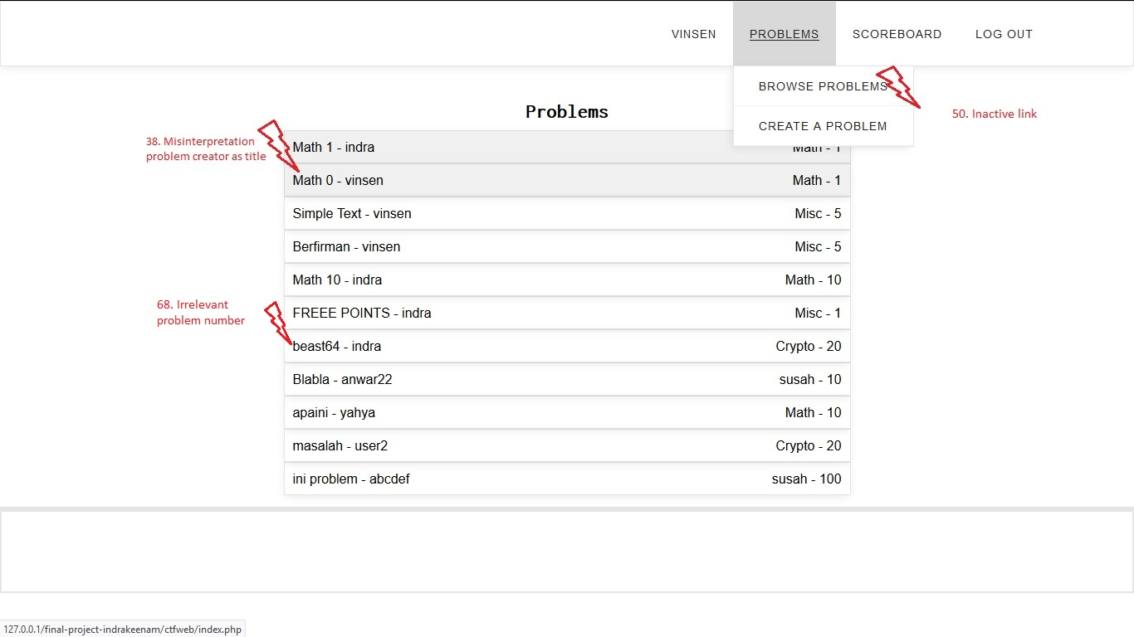
Contextual Analysis
2
Artifact Model
Notes:
Competitive Programming is similar with CTF when doing their competition

Slide 13
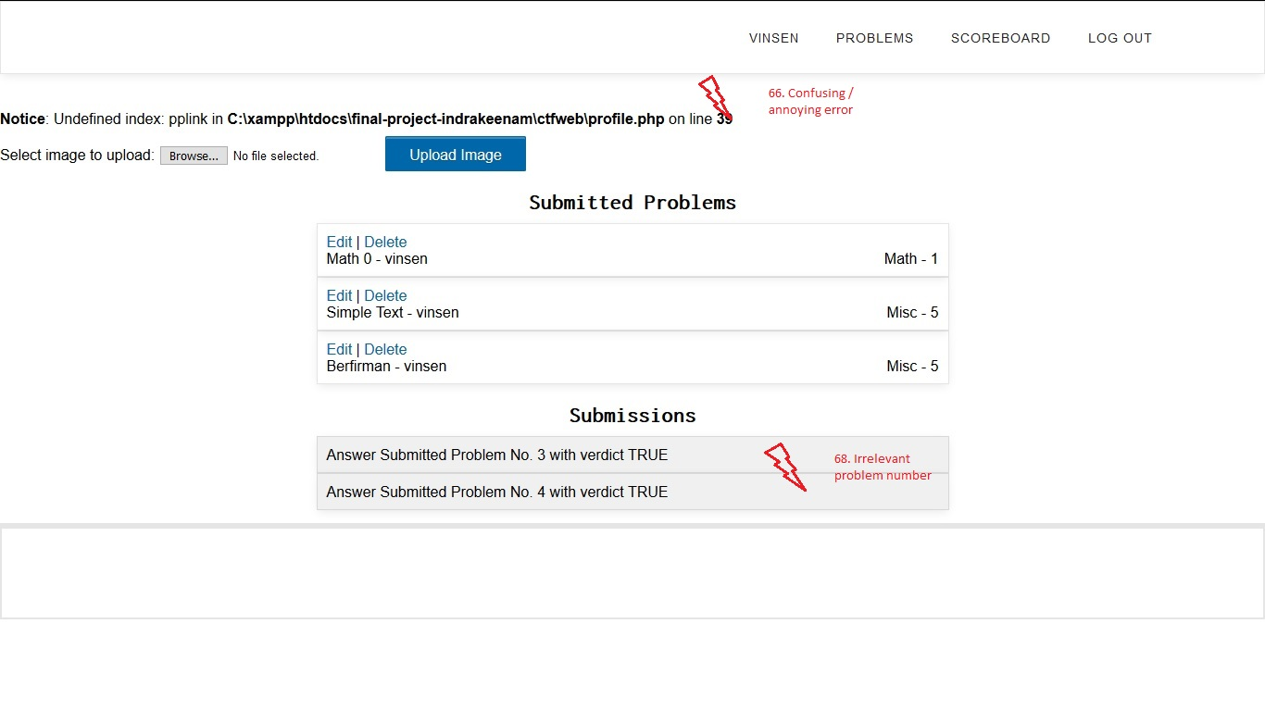
Contextual Analysis
2
Artifact Model
Notes:
Competitive Programming is similar with CTF when doing their competition

Slide 14
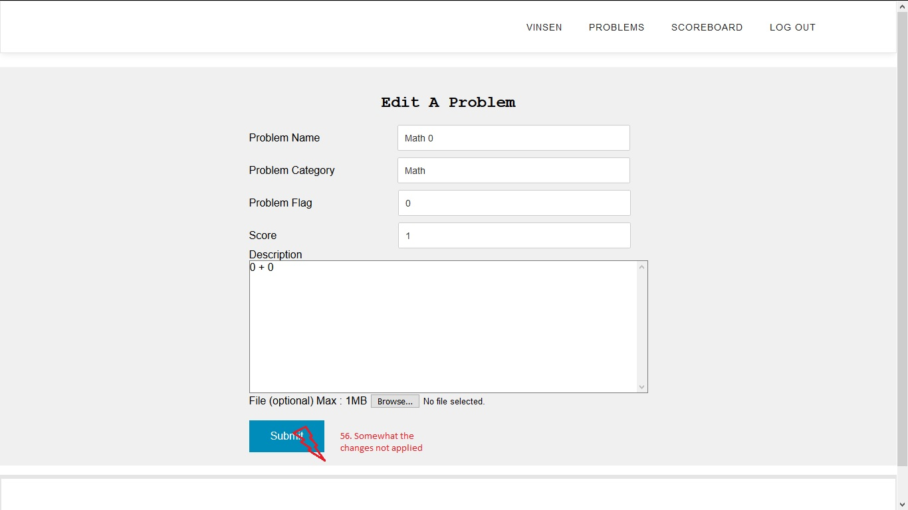
Contextual Analysis
2
Artifact Model
Notes:
Competitive Programming is similar with CTF when doing their competition

Slide 15

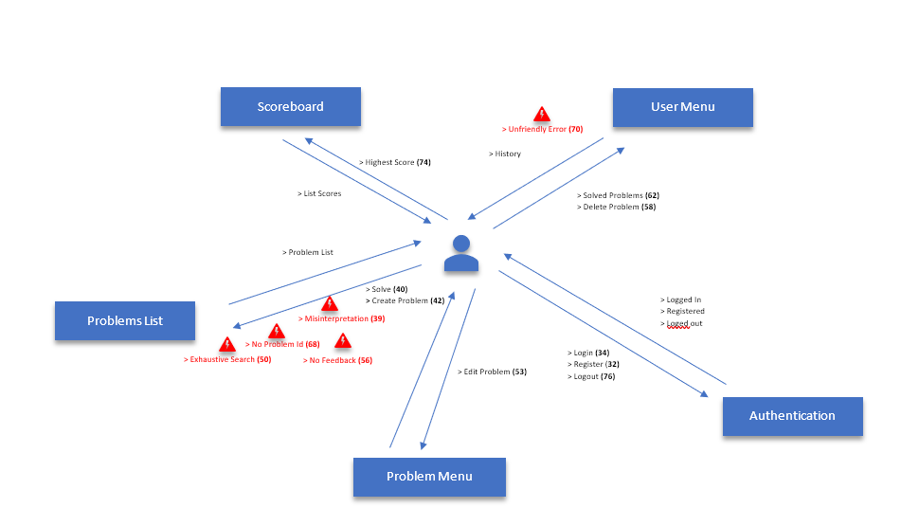
Contextual Analysis
2
Flow Model
Notes:
Competitive Programming is similar with CTF when doing their competition

Slide 16
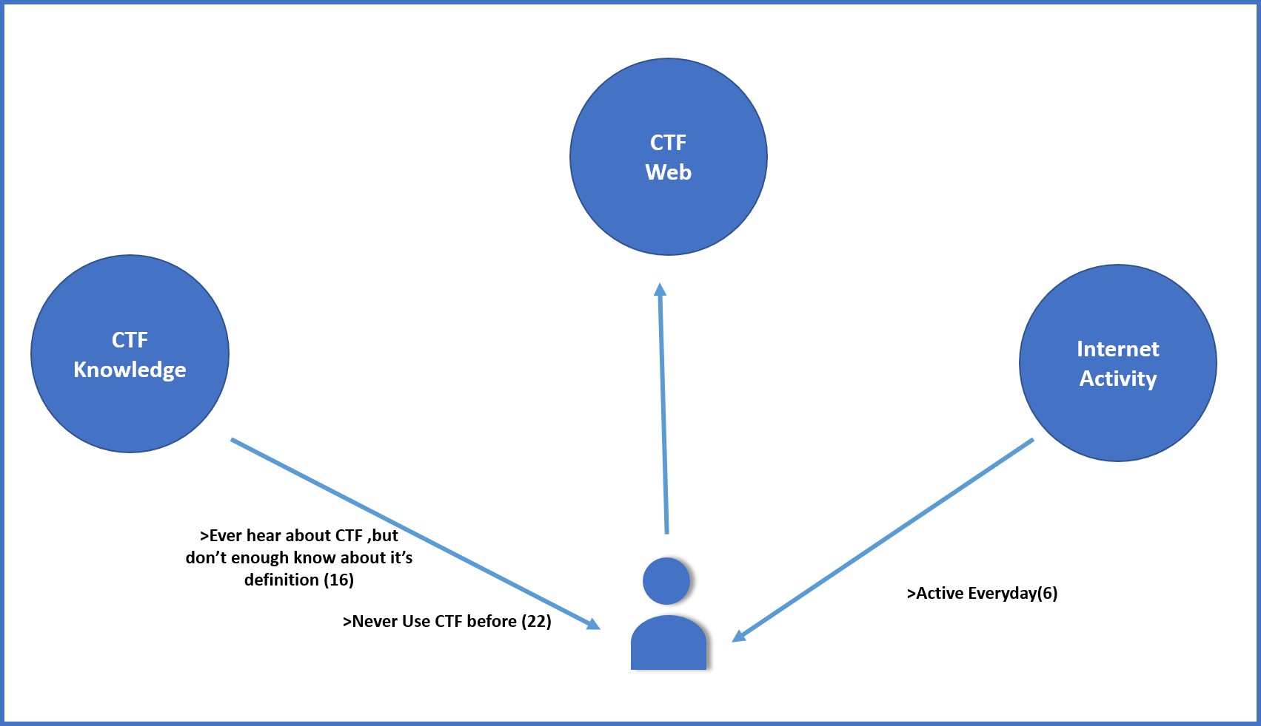
Contextual Analysis
2
Cultural Model
Notes:
Competitive Programming is similar with CTF when doing their competition

Slide 17
Contextual Inquiry
User
Descriptions
3
Male
Informatics Student
Batch 2017
Active
CTF User
Active
CTF Website User
Active
Understand
Notes:
Competitive Programming is similar with CTF when doing their competition

Slide 18
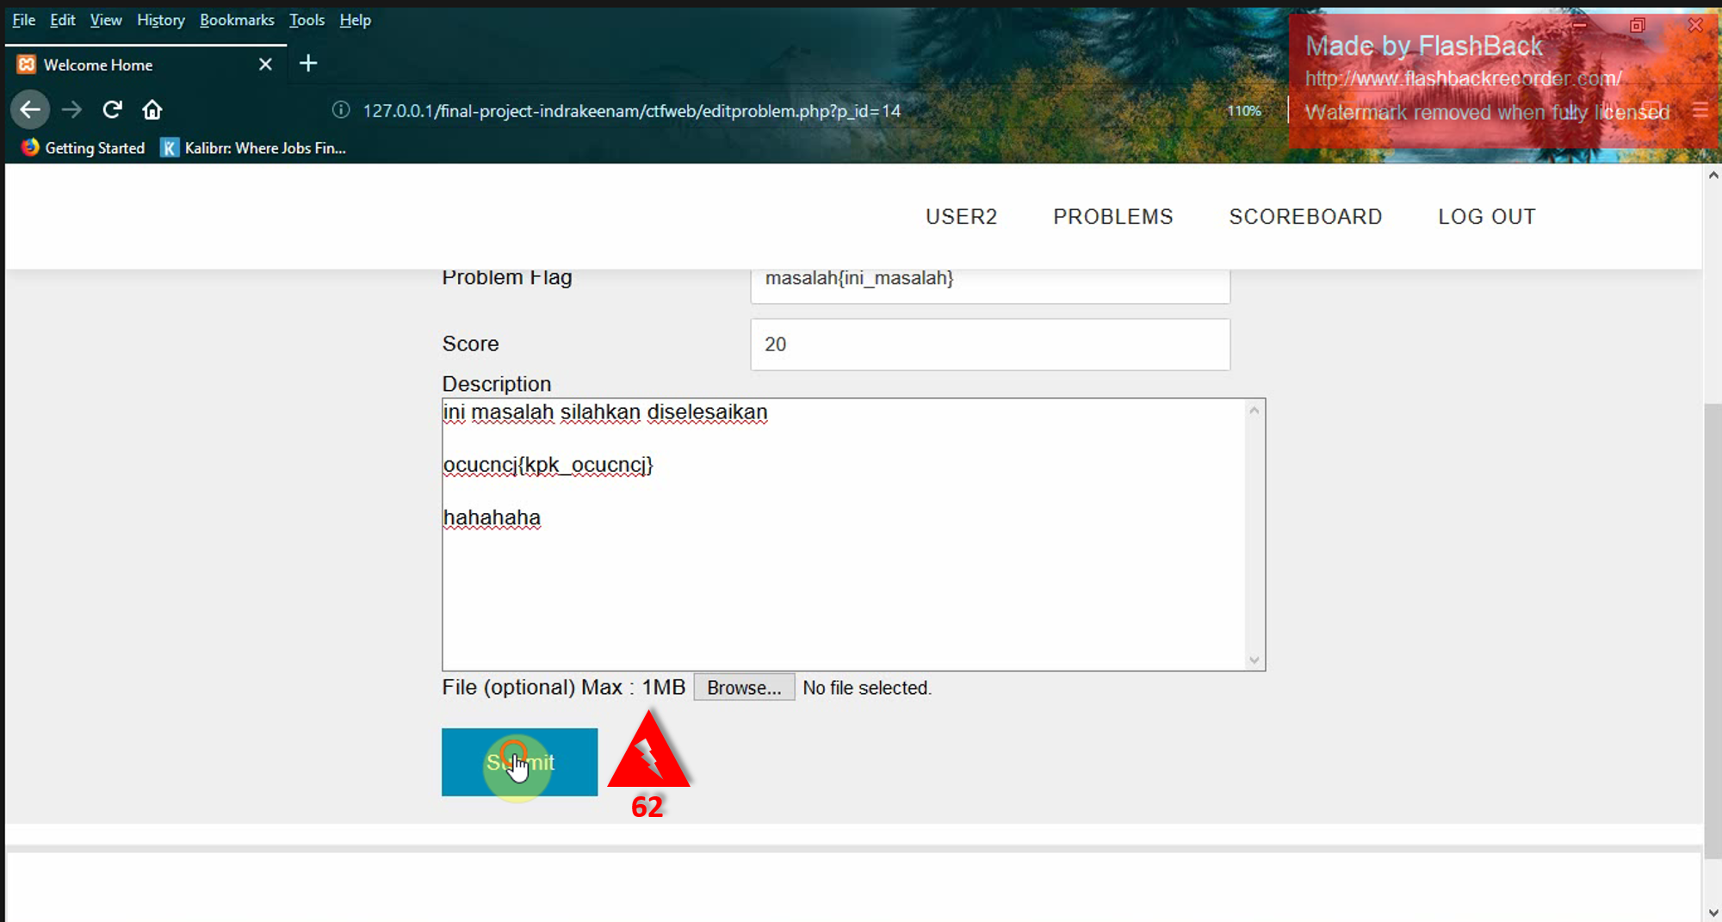
Contextual Analysis
3
Artifact Model
Notes:
Competitive Programming is similar with CTF when doing their competition

Slide 19
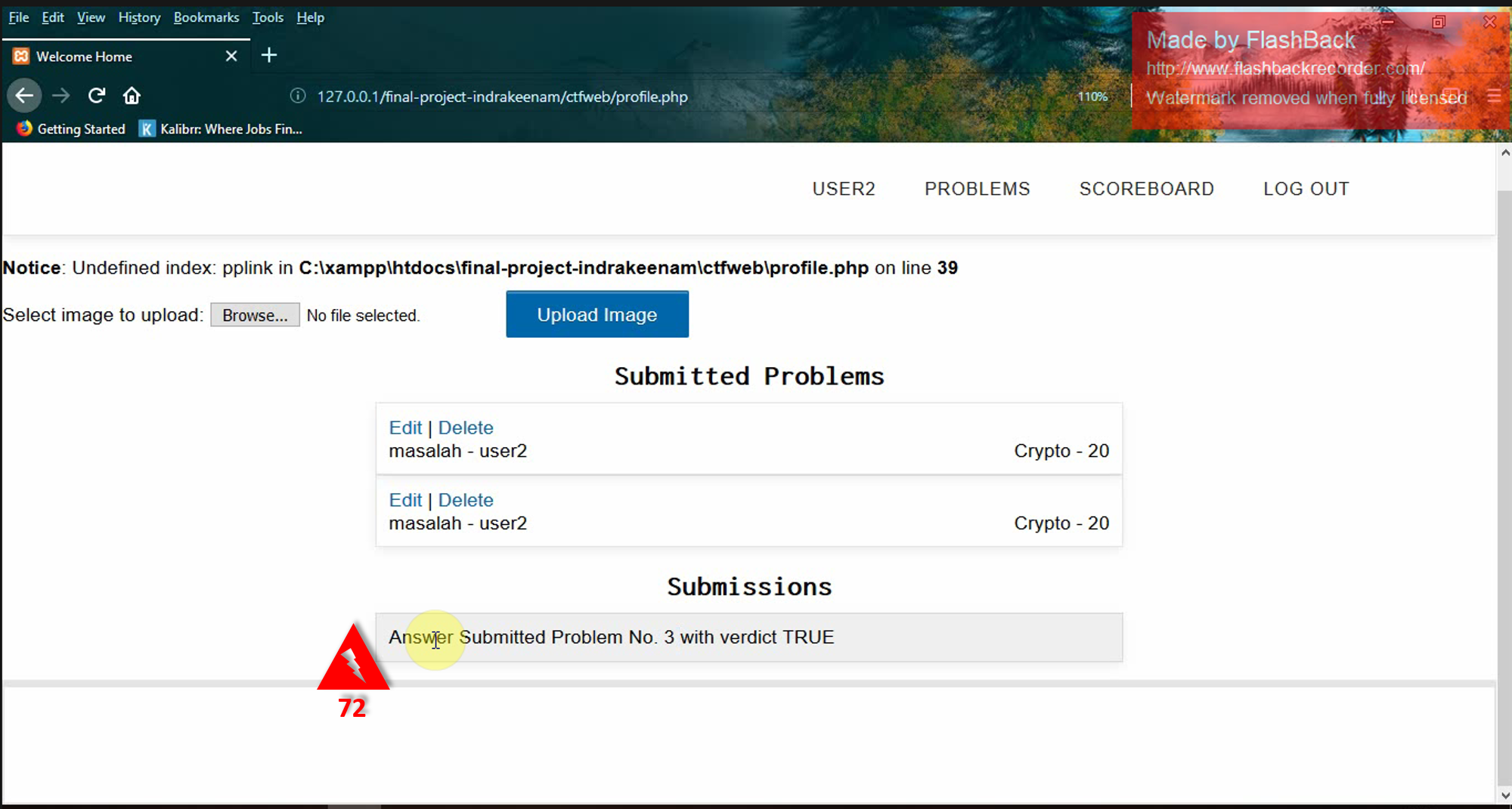
Contextual Analysis
3
Artifact Model
Notes:
Competitive Programming is similar with CTF when doing their competition

Slide 20
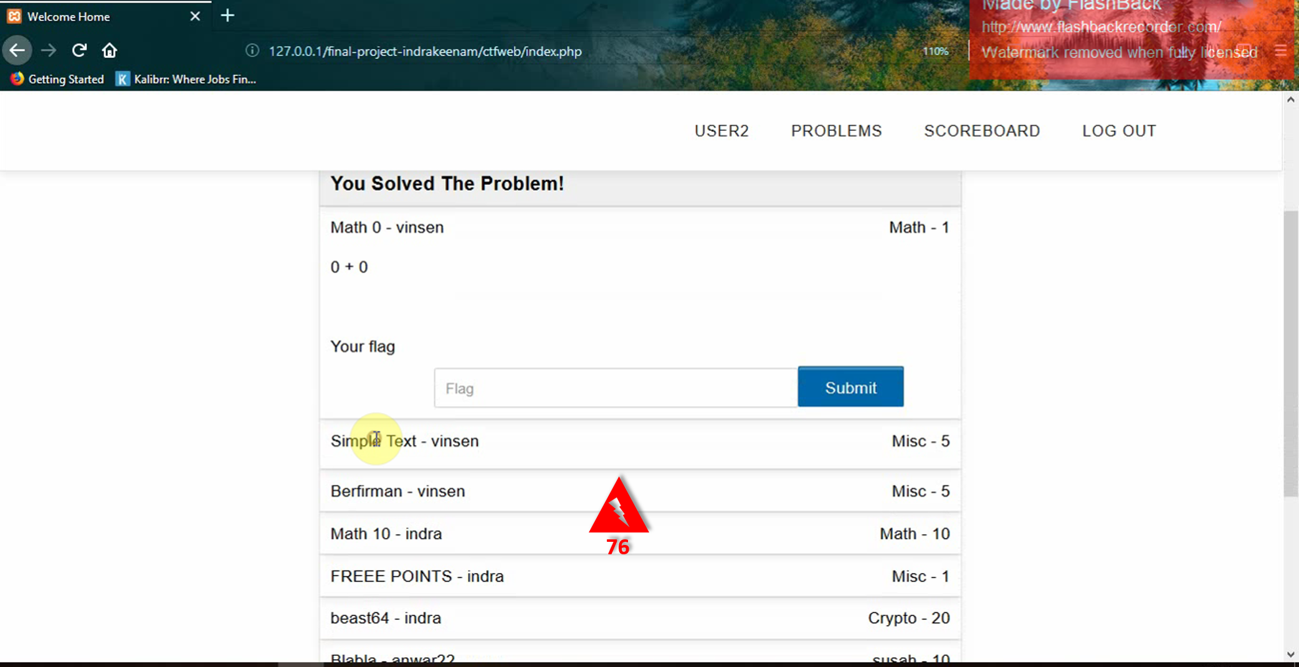
Contextual Analysis
3
Artifact Model
Notes:
Competitive Programming is similar with CTF when doing their competition

Slide 21
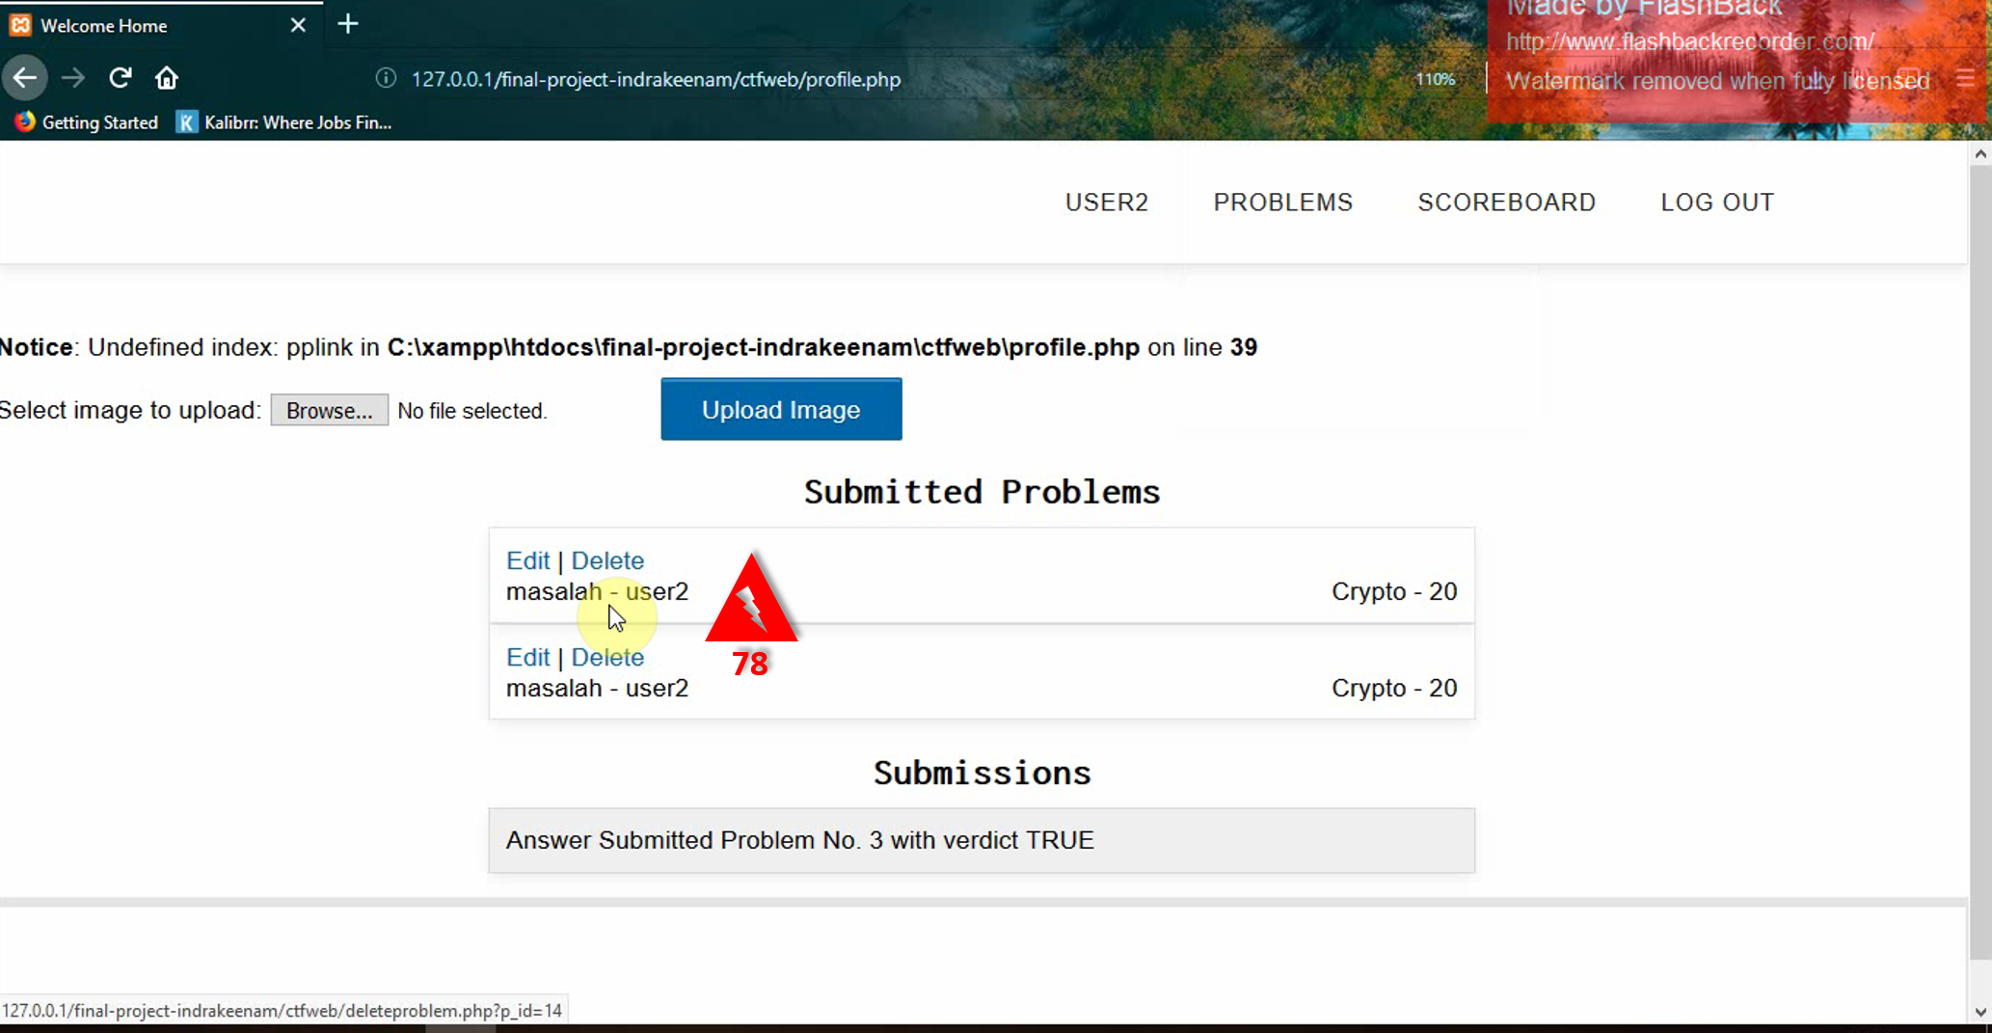
Contextual Analysis
3
Artifact Model
Notes:
Competitive Programming is similar with CTF when doing their competition

Slide 22
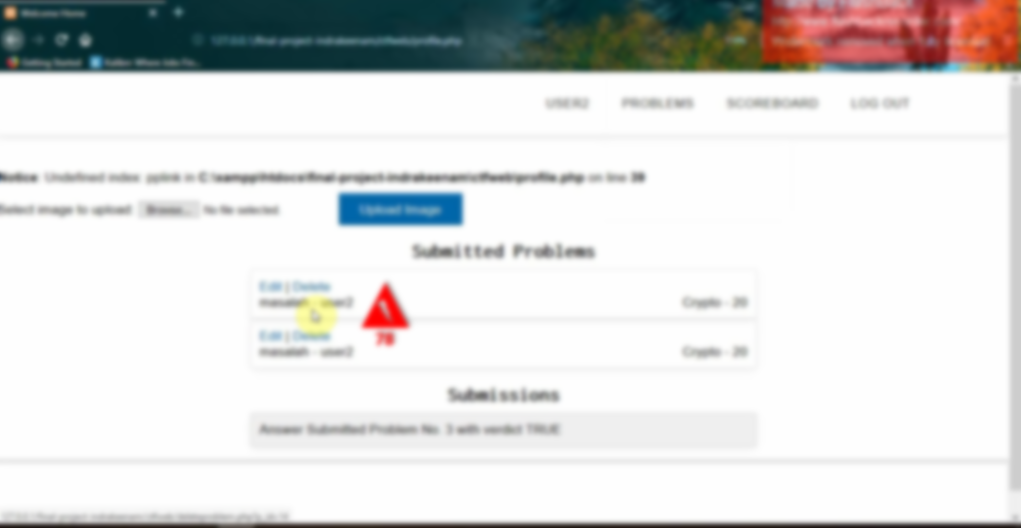
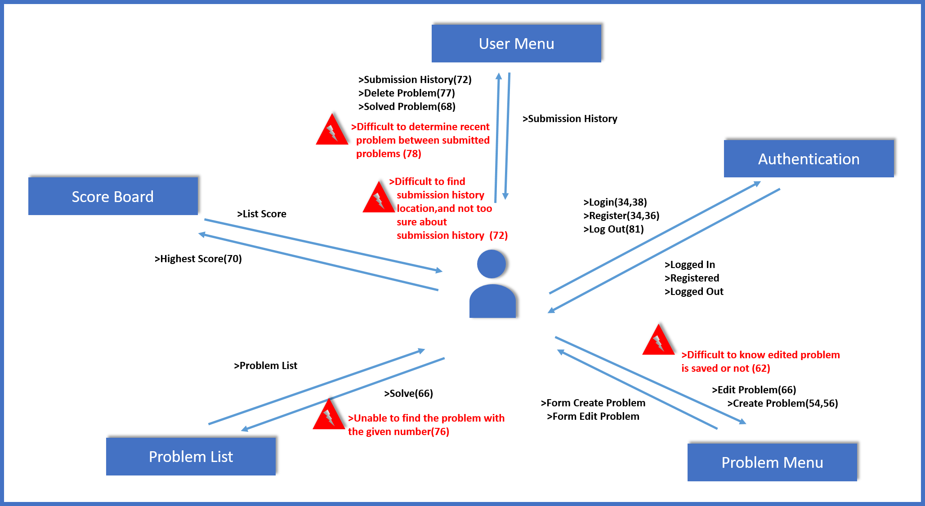
Contextual Analysis
3
Flow Model
Notes:
Competitive Programming is similar with CTF when doing their competition

Slide 23
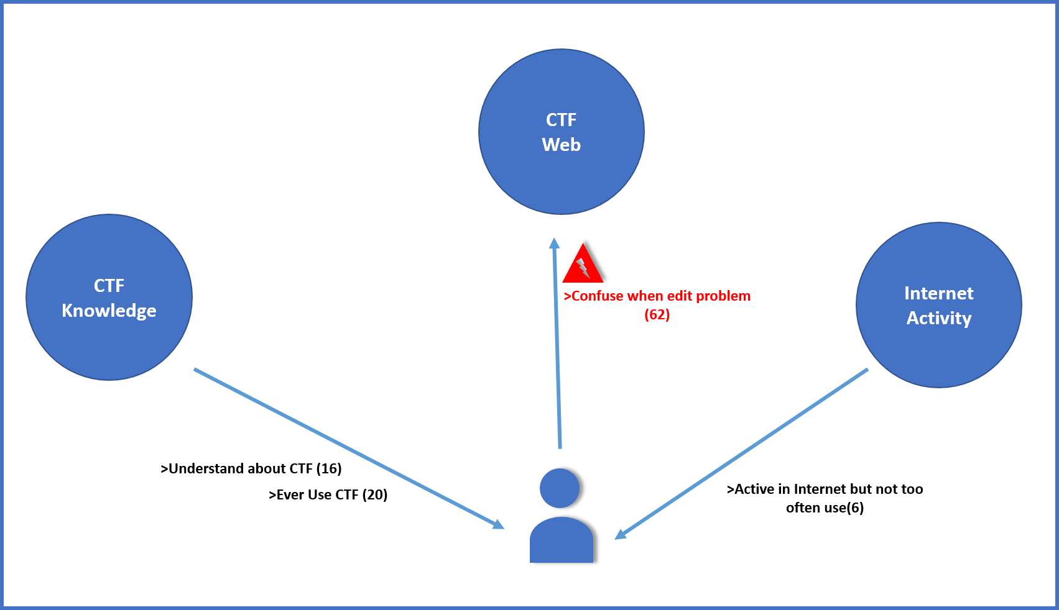
Contextual Analysis
3
Cultural Model
Notes:
Competitive Programming is similar with CTF when doing their competition

Slide 24
Contextual Inquiry
User
Descriptions
4
Male
Informatics Student
Batch 2016
Never
Do CTF Before
Seen
CTF Website
Know
CTF by Activity and View
Notes:
Competitive Programming is similar with CTF when doing their competition

Slide 25
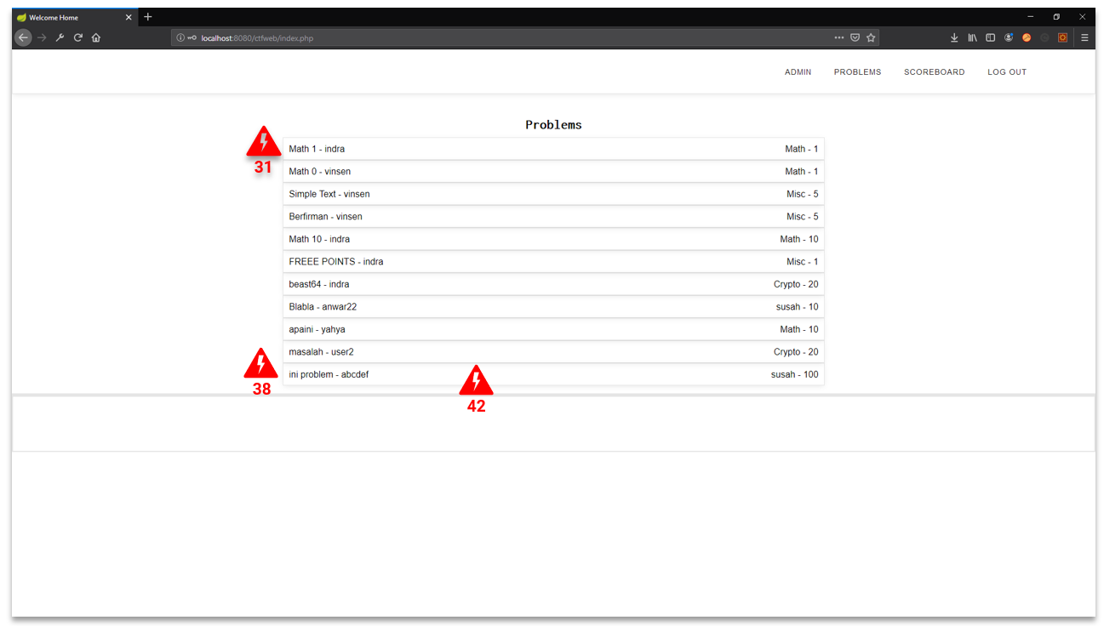
Contextual Analysis
4
Artifact Model
Notes:
Competitive Programming is similar with CTF when doing their competition

Slide 26
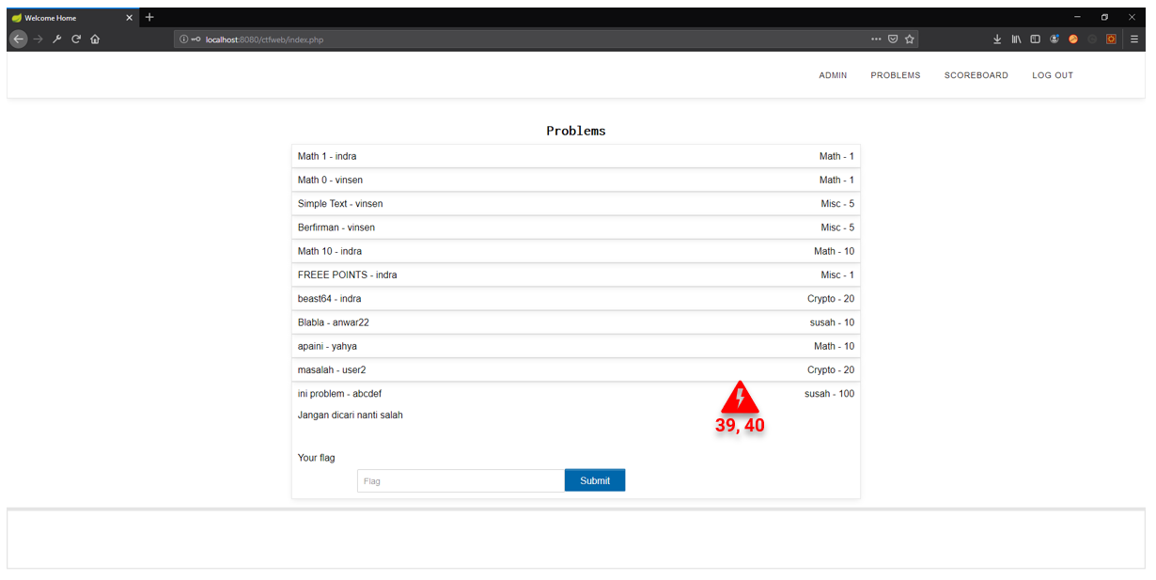
Contextual Analysis
4
Artifact Model
Notes:
Competitive Programming is similar with CTF when doing their competition

Slide 27
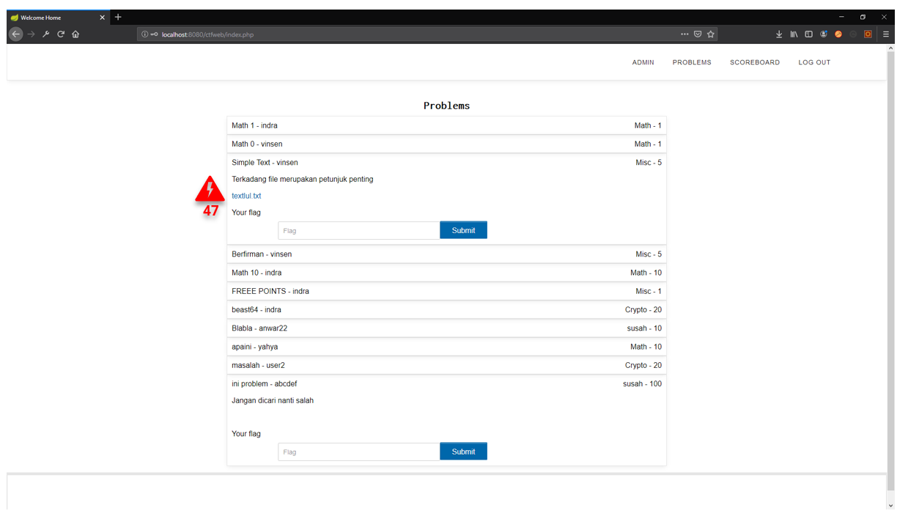
Contextual Analysis
4
Artifact Model
Notes:
Competitive Programming is similar with CTF when doing their competition

Slide 28
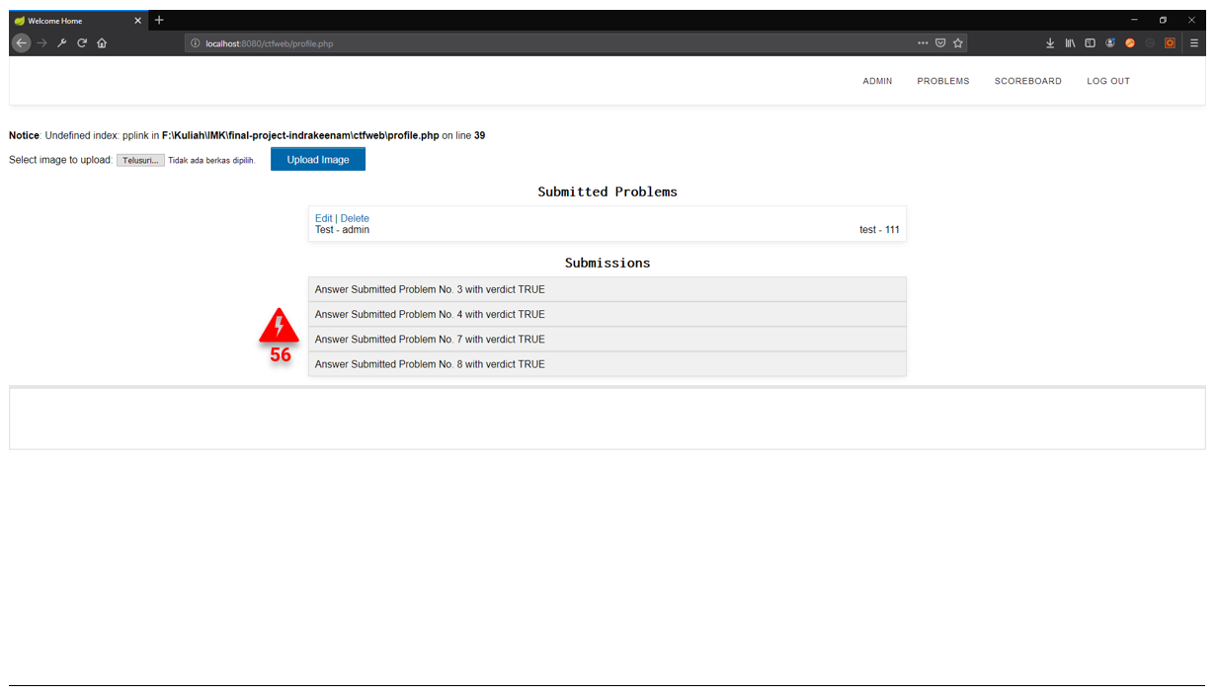
Contextual Analysis
4
Artifact Model
Notes:
Competitive Programming is similar with CTF when doing their competition

Slide 29
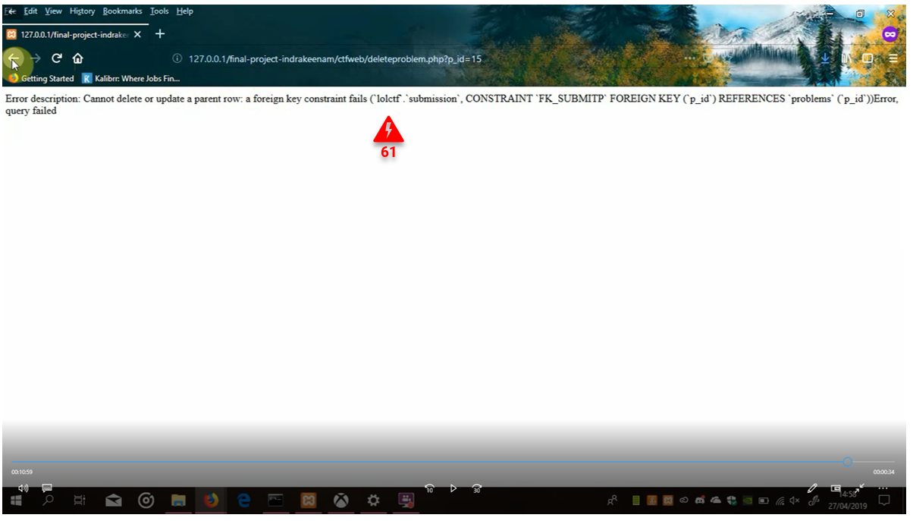
Contextual Analysis
4
Artifact Model
Notes:
Competitive Programming is similar with CTF when doing their competition

Slide 30

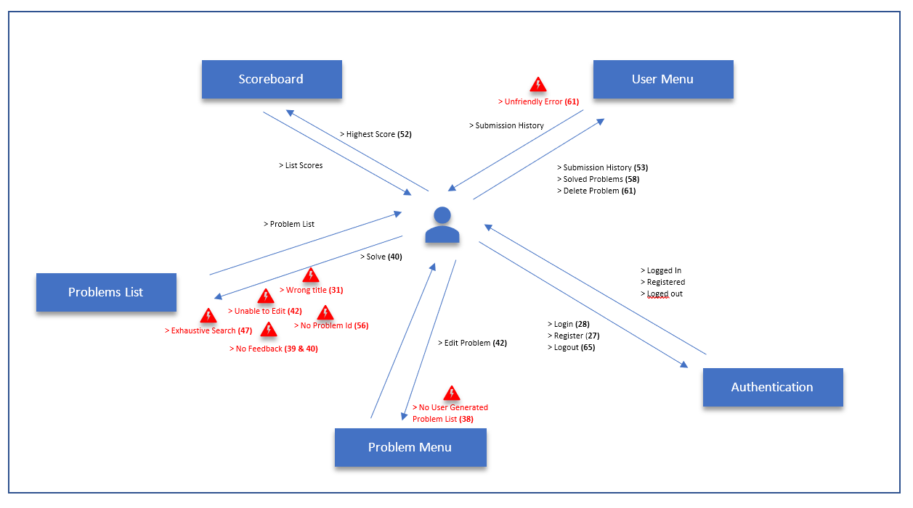
Contextual Analysis
4
Flow Model
Notes:
Competitive Programming is similar with CTF when doing their competition

Slide 31
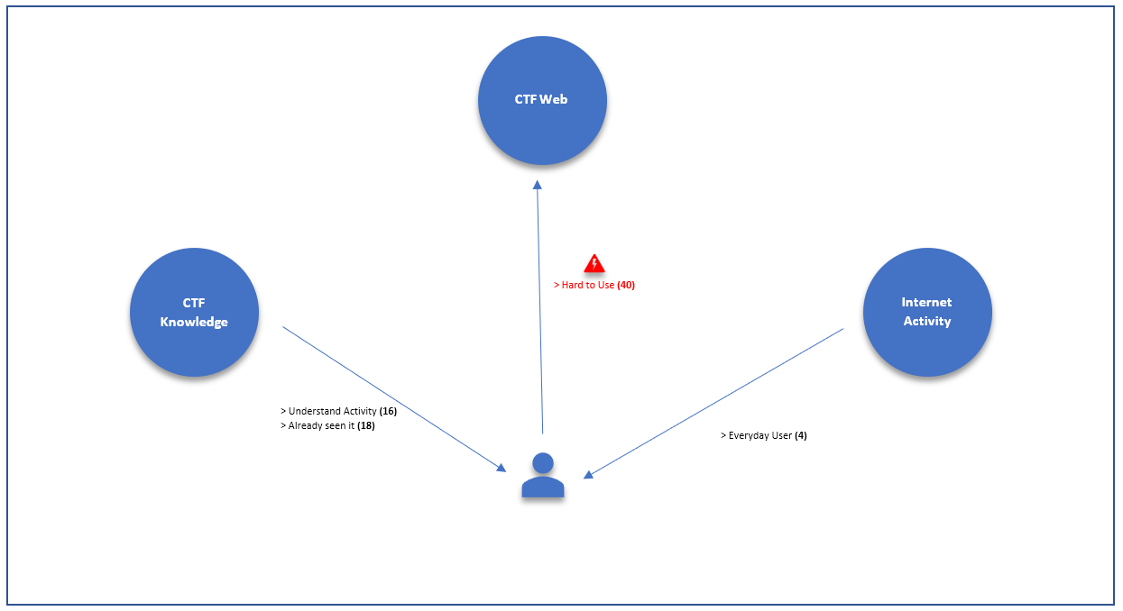
Contextual Analysis
4
Cultural Model
Notes:
Competitive Programming is similar with CTF when doing their competition

Slide 32
Contextual Analysis
Do’s
And Don’ts
Do
Don’t
Give feedback on user action
Be consistent
Group menu correctly
Give hint (indicator) if some task had been finished by User
Add capabilites of Sort descending problems which submitted by User by date or give date of submitted problem
Have functional system
Make useless navigation
Leave cryptics error
Use number in someplace and then use it's title in other place (inconsistent)
Notes:
Competitive Programming is similar with CTF when doing their competition

Slide 33
Thank You!
By Indrakeenam

